Slide 1
Collective Modes
in Gapless Systems
Kaifa Luo
kaifaluo@foxmail.com
2018/04/12

Slide 2

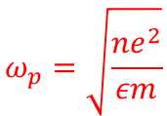

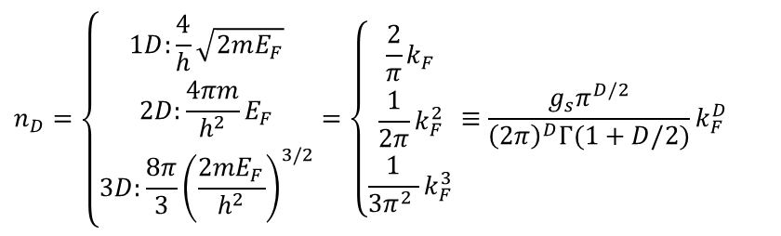
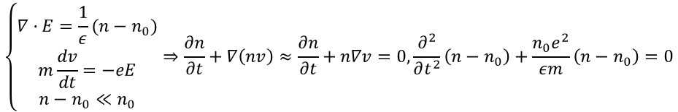




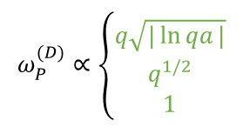
Classic Results of Parabolic Systems
Long-wavelength Plasmon in metals (e-e interation, Jellium model)
$$\left\{\begin{aligned}∇·E=\frac{1}{ε}(n−n_{0}) \\ m\frac{dv}{dt}=−eE \\ n−n_{0}≪n_{0}\end{aligned}\right.⇒\frac{∂n}{∂t}+∇\left(nv\right)≈\frac{∂n}{∂t}+n∇v=0, \frac{∂^{2}}{∂t^{2}}\left(n−n_{0}\right)+\frac{n_{0}e^{2}}{εm}\left(n−n_{0}\right)=0$$
Classical
Picture
$$ω_{p}=\sqrt{\frac{ne^{2}}{εm}}$$
$$P\left(q,ω\right)≈\frac{n}{m}\frac{q^{2}}{ω^{2}}+O\left(\frac{q^{4}}{ω^{4}}\right) \& ε\left(q,ω_{P}\right)=1−v\left(q\right)P\left(q,ω_{P}\right)=0$$
$$ω_{P}^{(1)}=\sqrt{2e^{2}/κm}·n_{1}^{1/2}q\sqrt{|\ln{qa}|}+O\left(q^{3}\right)$$
$$ω_{P}^{(D)}∝n_{D}^{1/2}$$
$$ω_{P}^{(2)}=\sqrt{2πe^{2}/κm}·n_{2}^{1/2}q^{1/2}+O\left(q^{3/2}\right)$$
$$ω_{P}^{(D)}∝\left\{\begin{aligned}q\sqrt{|\ln{qa}|} \\ q^{1/2} \\ 1\end{aligned}\right.$$
$$ω_{P}^{(3)}=\sqrt{4πe^{2}/κm}·n_{3}^{1/2}+O\left(q^{2}\right)$$
Electron Density (A. Sommerfeld, free electron gas, $T→0K$)
$$E(k)=\frac{ℏ^{2}k^{2}}{2m}$$
$$n_{D}=\left\{\begin{aligned}1D:\frac{4}{h}\sqrt{2mE_{F}} \\ 2D:\frac{4πm}{h^{2}}E_{F} \\ 3D:\frac{8π}{3}{\left(\frac{2mE_{F}}{h^{2}}\right)}^{3/2}\end{aligned}=\left\{\begin{aligned}\frac{2}{π}k_{F} \\ \frac{1}{2π}k_{F}^{2} \\ \frac{1}{3π^{2} }k_{F}^{3}\end{aligned}\right.≡\frac{g_{s}π^{D/2}}{{\left(2π\right)}^{D}Γ(1+D/2)}k_{F}^{D}\right.$$
Electrons around the Fermi surface contribute to the collective modes.
H. Haug et al, Quantum theory of the optical and electronic properties of semiconductors

Slide 3
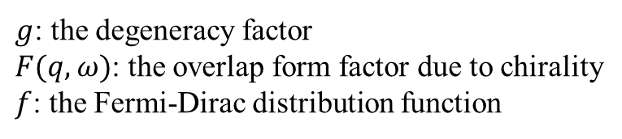

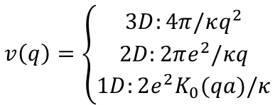
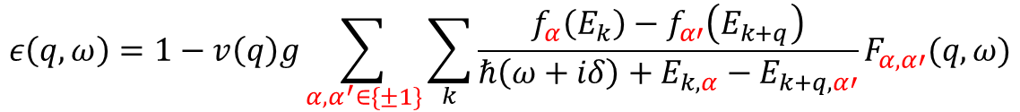

Lindhard Theory (RPA+1st Pertu.)
To calculating the effects of electric field screening by electrons in a solid.
The Lindhard formula of dielectric function
$$ε\left(q,ω\right)=1−v\left(q\right)P\left(q,ω\right)=1−v\left(q\right)g\sum_{k}{\frac{f\left(E_{k}\right)−f\left(E_{k+q}\right)}{ℏ\left(ω+iδ\right)+E_{k}−E_{k+q}}F(q,ω)}$$
$g$: the degeneracy factor
$F(q,ω)$: the overlap form factor due to chirality
$f$: the Fermi-Dirac distribution function
$$v\left(q\right)=\left\{\begin{aligned}3D:4π/κq^{2} \\ 2D:2πe^{2}/κq \\ 1D:2e^{2}K_{0}(qa)/κ\end{aligned}\right.$$
The Lindhard formula for two-band model
$$ε\left(q,ω\right)=1−v\left(q\right)g\sum_{α,α^{′}∈\{±1\}}{\sum_{k}{\frac{f_{α}\left(E_{k}\right)−f_{α′}\left(E_{k+q}\right)}{ℏ\left(ω+iδ\right)+E_{k,α}−E_{k+q,α′}}F_{α,α′}(q,ω)}}$$
The longitudinal plasma eigen-modes: $Re\left[ε\left(q,ω\right)\right]=0$
$$φ\left(q,ω\right)=\frac{φ^{e}(q,ω)}{ε(q,ω)}$$
$$\lim_{δ→0^{+}}{\frac{1}{z−iδ}}=P\left(\frac{1}{z}\right)+iπδ(z)$$
$$\left|z\right|≫0⇒δ\left(z\right)=0⇒Im\left(ε\right)=0$$
Prasanta K. Misra, Physics of Condensed Matter, Ch-7.4
H. Haug et al, Quantum theory of the optical and electronic properties of semiconductors, Ch-8

Slide 4
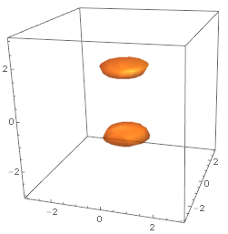
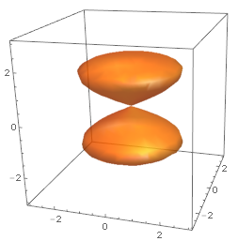
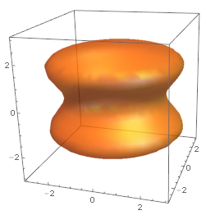
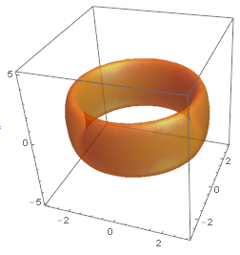
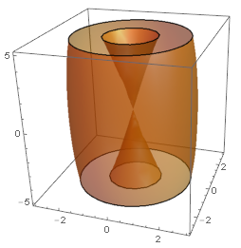
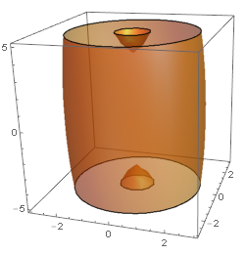
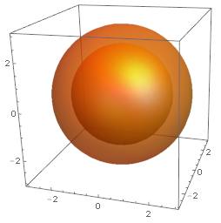
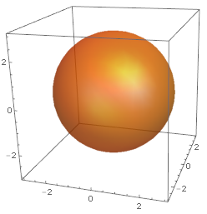











Hamiltonian and Fermi Surface of semimetals
Weyl semimetal
$$H=k_{x}σ_{x}+k_{y}σ_{y}+\left(m−Bk_{z}^{2}\right)σ_{z}$$
$$E_{F}^{2}={\left(m−Bk_{z}^{2}\right)}^{2}+k_{⊥}^{2}$$
Nodal line semimetal
$$H=\left(m−Bk_{⊥}^{2}\right)σ_{x}+k_{z}σ_{z}$$
$$E_{F}^{2}={\left(m−Bk_{⊥}^{2}\right)}^{2}+k_{z}^{2}$$
$$k_{⊥}^{2}=\frac{m±\sqrt{E_{F}^{2}−k_{z}^{2}}}{B}$$
Nodal sphere semimetal
$$H=\left(m−Bk^{2}\right)σ_{z}$$
$$E_{F}^{2}={\left(m−Bk^{2}\right)}^{2}$$
$$k^{2}=\frac{m±\left|E_{F}\right|}{B}$$
$$E_{F}<m$$
$$E_{F}=m$$
$$E_{F}>m$$

Slide 5

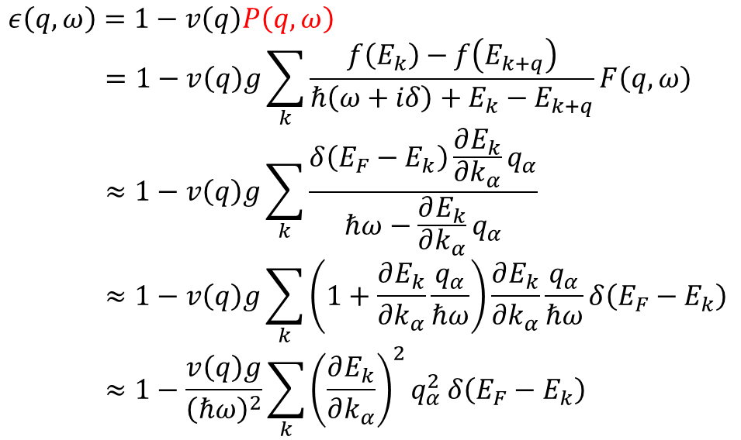


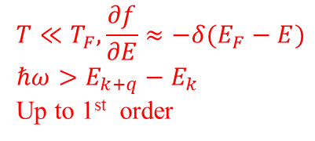
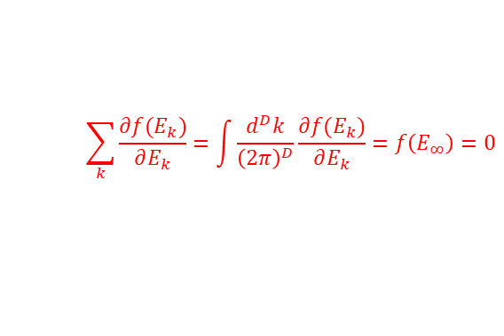
Roughly Thinking about $ω_{P}^{D}$
$$ε\left(q,ω\right)=1−v\left(q\right)P\left(q,ω\right)$$
$$=1−v\left(q\right)g\sum_{k}{\frac{f\left(E_{k}\right)−f\left(E_{k+q}\right)}{ℏ\left(ω+iδ\right)+E_{k}−E_{k+q}}F\left(q,ω\right)}$$
$$≈1−v\left(q\right)g\sum_{k}{\frac{δ\left(E_{F}−E_{k}\right)\frac{∂E_{k}}{∂k_{α}}q_{α}}{ℏω−\frac{∂E_{k}}{∂k_{α}}q_{α}}}$$
$$≈1−v\left(q\right)g\sum_{k}{\left(1+\frac{∂E_{k}}{∂k_{α}}\frac{q_{α}}{ℏω}\right)\frac{∂E_{k}}{∂k_{α}}\frac{q_{α}}{ℏω}}δ\left(E_{F}−E_{k}\right)$$
$$≈1−\frac{v\left(q\right)g}{{\left(ℏω\right)}^{2}}\sum_{k}{{\left(\frac{∂E_{k}}{∂k_{α}}\right)}^{2}q_{α}^{2}}δ\left(E_{F}−E_{k}\right)$$
$$T≪T_{F},\frac{∂f}{∂E}≈−δ(E_{F}−E)$$
$$ℏω>E_{k+q}−E_{k}$$
Up to 1st order
$${\left(1−x\right)}^{−1}≈1+x$$
$$\sum_{k}{\frac{∂f(E_{k})}{∂E_{k}}=\int{\frac{d^{D}k}{{\left(2π\right)}^{D}}\frac{∂f(E_{k})}{∂E_{k}}=f\left(E_{∞}\right)=0}}$$
$$P\left(q,ω\right)∝\frac{q^{2}}{ω^{2}}$$
Plasma dispersion $ω_{P}(q)$ seems to be the same up to prefactors.
$$\frac{∂E_{k}}{∂k}$$
Different Energy dispersion may bring up something new.

Slide 6

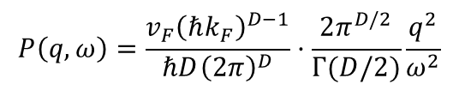
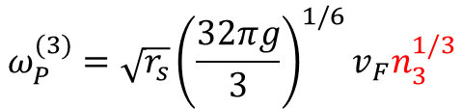








Collective modes of Dirac Plasma
$$E_{k}=ℏv_{F}k$$
Plasmon frequency
Dependent of electron density
$$P\left(q,ω\right)=\frac{v_{F}{\left(ℏk_{F}\right)}^{D−1}}{ℏD{\left(2π\right)}^{D}}·\frac{2π^{D/2}}{Γ(D/2)}\frac{q^{2}}{ω^{2}}$$
$$ω_{P}^{(1)}∝1$$
$$ω_{P}^{(2)}∝n_{2}^{1/4}$$
$$1−v\left(q\right)P\left(q,ω_{P}\right)=0⇒ω_{P}$$
$$ω_{P}^{(3)}∝n_{3}^{1/3}$$
$$ω_{P}^{(1)}=\sqrt{r_{s}}\sqrt{\frac{g}{π}}v_{F}q\sqrt{|\ln{qa}|}$$
Dependent of Planck constant
$$ω_{P}^{(2)}=\sqrt{r_{s}}{\left(gπ\right)}^{1/4}v_{F}n_{2}^{1/4}q^{1/2}$$
$$ω_{P}^{(3)}=\sqrt{r_{s}}{\left(\frac{32πg}{3}\right)}^{1/6}v_{F}n_{3}^{1/3}$$
$$ω_{P}^{(D)}∝ℏ^{−1/2}$$
$$r_{s}=\frac{e^{2}}{κℏv_{F}}$$
No classical correspondence.
S. Das Sarma et al, PRB 75, 205418 (2007)
S. Das Sarma et al, PRL 102, 206412 (2009)

Slide 7

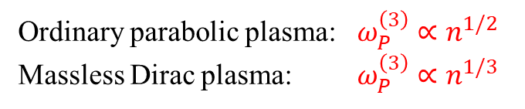

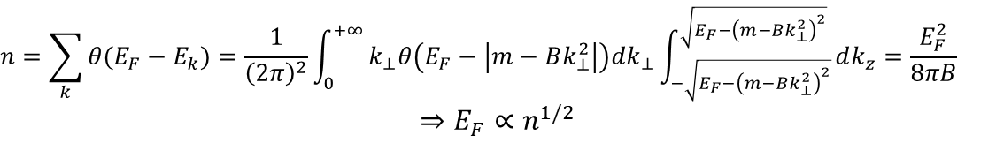
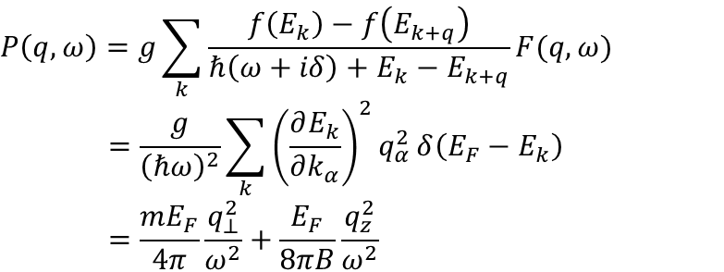
Collective modes in nodal line semimetals
Polarizability
$$P\left(q,ω\right)=g\sum_{k}{\frac{f\left(E_{k}\right)−f\left(E_{k+q}\right)}{ℏ\left(ω+iδ\right)+E_{k}−E_{k+q}}F(q,ω)}$$
$$=\frac{g}{{\left(ℏω\right)}^{2}}\sum_{k}{{\left(\frac{∂E_{k}}{∂k_{α}}\right)}^{2}q_{α}^{2}}δ\left(E_{F}−E_{k}\right)$$
$$=\frac{mE_{F}}{4π}\frac{q_{⊥}^{2}}{ω^{2}}+\frac{E_{F}}{8πB}\frac{q_{z}^{2}}{ω^{2}}$$
$$E_{F}^{2}={\left(m−Bk_{⊥}^{2}\right)}^{2}+k_{z}^{2}$$
Electron density
$$n=\sum_{k}{θ(E_{F}−E_{k})}=\frac{1}{{\left(2π\right)}^{2}}\int_{0}^{+∞}{k_{⊥}θ\left(E_{F}−\left|m−Bk_{⊥}^{2}\right|\right)dk_{⊥}\int_{−\sqrt{E_{F}−{\left(m−Bk_{⊥}^{2}\right)}^{2}}}^{\sqrt{E_{F}−{\left(m−Bk_{⊥}^{2}\right)}^{2}}}{dk_{z}}}=\frac{E_{F}^{2}}{8πB}$$
$$⇒E_{F}∝n^{1/2}$$
The Lindhard formula
$$1−v\left(q\right)P\left(q,ω\right)=1−\frac{4π}{κq^{2}}P\left(q,ω\right)=0⇒ω_{P}^{\left(3\right)}∝n^{1/4}$$
Ordinary parabolic plasma: $ω_{P}^{\left(3\right)}∝n^{1/2}$
Massless Dirac plasma: $ω_{P}^{\left(3\right)}∝n^{1/3}$
Zhongbo Yan et al, PRB 93,085138 (2016)

Slide 8

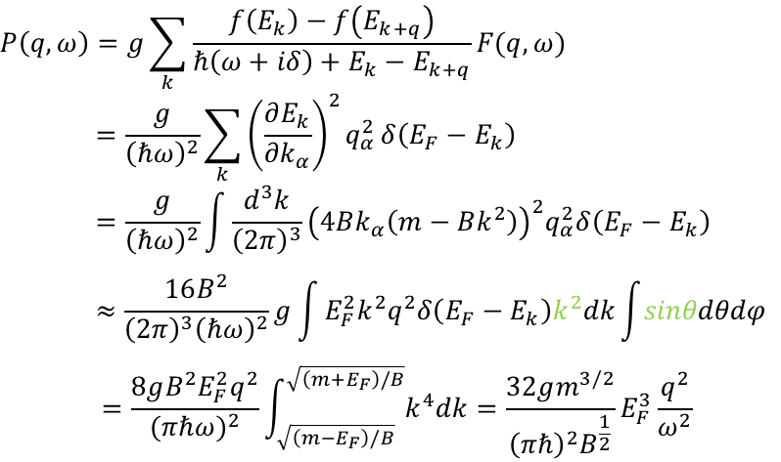




Collective modes in nodal sphere semimetals
Polarizability
$$m≫E_{F}>0$$
$$P\left(q,ω\right)=g\sum_{k}{\frac{f\left(E_{k}\right)−f\left(E_{k+q}\right)}{ℏ\left(ω+iδ\right)+E_{k}−E_{k+q}}F(q,ω)}$$
$$=\frac{g}{{\left(ℏω\right)}^{2}}\sum_{k}{{\left(\frac{∂E_{k}}{∂k_{α}}\right)}^{2}q_{α}^{2}}δ\left(E_{F}−E_{k}\right)$$
$$=\frac{g}{{\left(ℏω\right)}^{2}}\int{\frac{d^{3}k}{{\left(2π\right)}^{3}}{\left(4Bk_{α}\left(m−Bk^{2}\right)\right)}^{2}q_{α}^{2}δ\left(E_{F}−E_{k}\right)}$$
$$≈\frac{16B^{2}}{{\left(2π\right)}^{3}{\left(ℏω\right)}^{2}}g\int{E_{F}^{2}k^{2}q^{2}δ\left(E_{F}−E_{k}\right)k^{2}dk\int{sinθdθdφ}}$$
$$=\frac{8gB^{2}E_{F}^{2}q^{2}}{{(πℏω)}^{2}}\int_{\sqrt{\left(m−E_{F}\right)/B}}^{\sqrt{\left(m+E_{F}\right)/B}}{k^{4}dk}=\frac{32gm^{3/2}}{{\left(πℏ\right)}^{2}B^{\frac{1}{2}}}E_{F}^{3}\frac{q^{2}}{ω^{2}}$$
$$k_{α}^{2}q_{α}^{2}≈k^{2}q^{2}$$
$$E_{F}^{2}={\left(m−Bk^{2}\right)}^{2}$$
$$k^{2}=\frac{m±\left|E_{F}\right|}{B}$$
Electron density
$$n=\sum_{k}{θ(E_{F}−E_{k})}=\frac{1}{{\left(2π\right)}^{3}}\int_{\sqrt{\left(m−E_{F}\right)/B}}^{\sqrt{\left(m+E_{F}\right)/B}}{4πk^{2}dk}=\frac{{\left(m+E_{F}\right)}^{3/2}−{\left(m−E_{F}\right)}^{3/2}}{3π^{2}B^{3/2}}≈\frac{m^{\frac{1}{2}}}{π^{2}B^{\frac{3}{2}}}E_{F}∝E_{F}$$
The Lindhard formula
$$1−v\left(q\right)P\left(q,ω\right)=1−\frac{4π}{κq^{2}}P\left(q,ω\right)=0⇒ω_{P}^{\left(3\right)}∝n^{3/2}$$

